Slide 1

Growing Chatbots Out of Thin-Air: Opportunities and Limits of Language Models for Guiding Themselves
Daniel Khashabi
Notes:
Thank you for having me! It's an honor to be here!

Slide 2
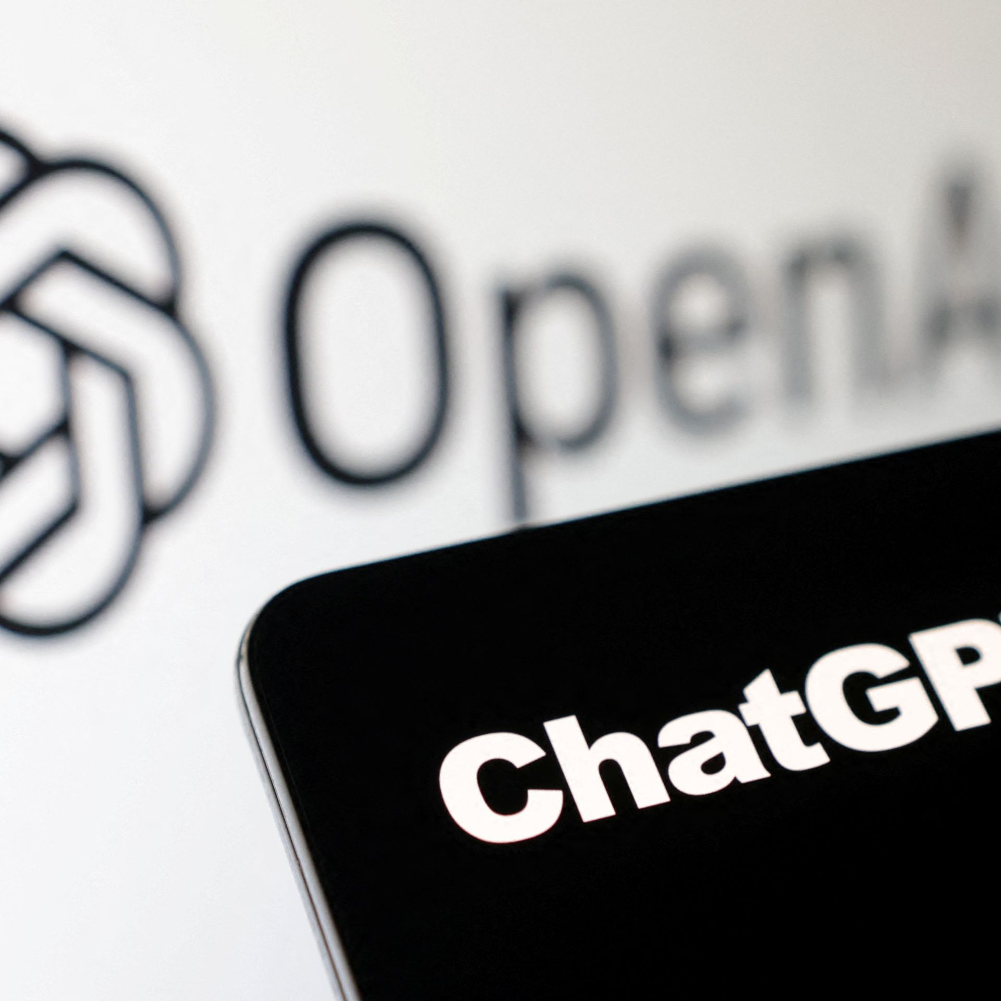
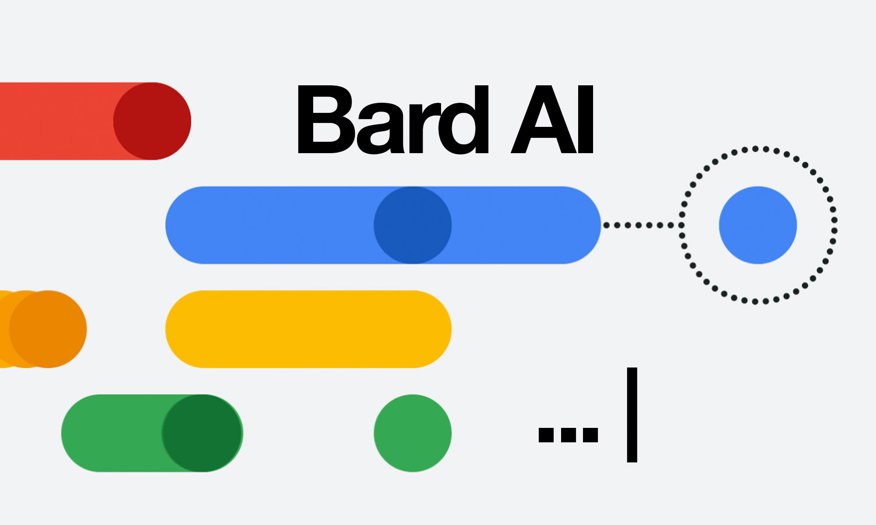


The success we dreamed of
Language models that are remarkably capable at solving many important NLP benchmarks.
Notes:
We live in an interesting era. We are at a point where we dreamed of years ago.
Language models that are remarkably capable at many important NLP task.

Slide 3
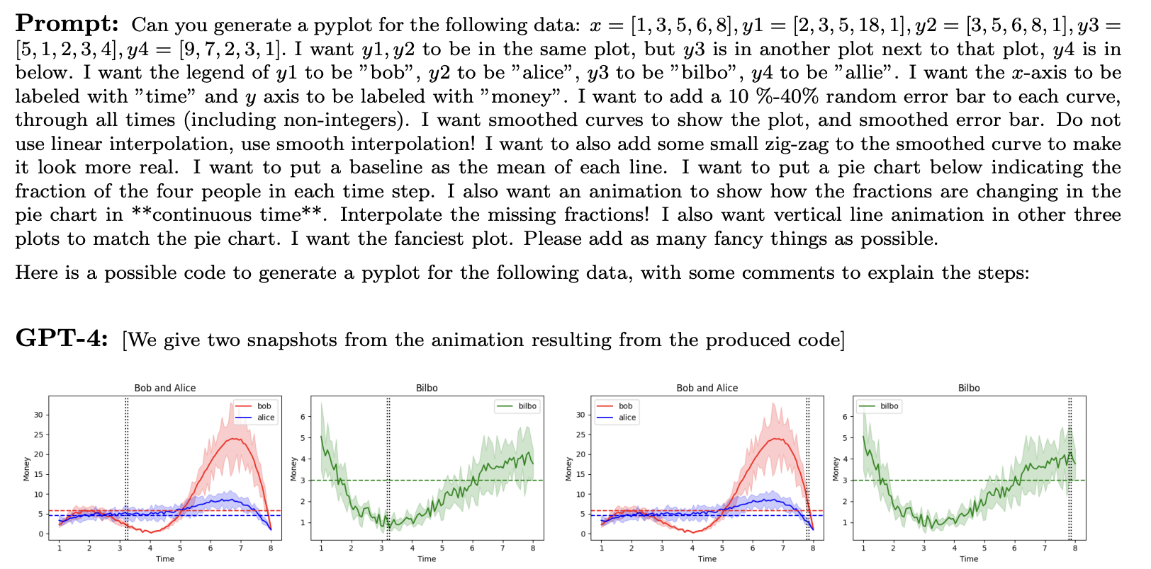
The Success We Dreamed Of
[Bubeck et al. 2023]
Notes:
Here is an example taken from the GPT4 tech report released about a year ago.
In this example, the model is capable of reading elaborate instructions and generating a corresponding figure. It's just wonderful!

Slide 4
The Success We Dreamed Of
[Wei et al. 2023; ….]
Notes:
Moreover, we observed the remarkable improvement in model performances, when they’re forced to detail their rationale.

Slide 5
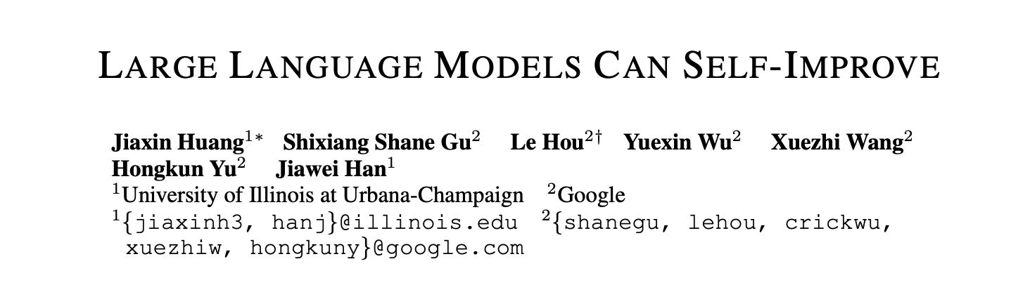
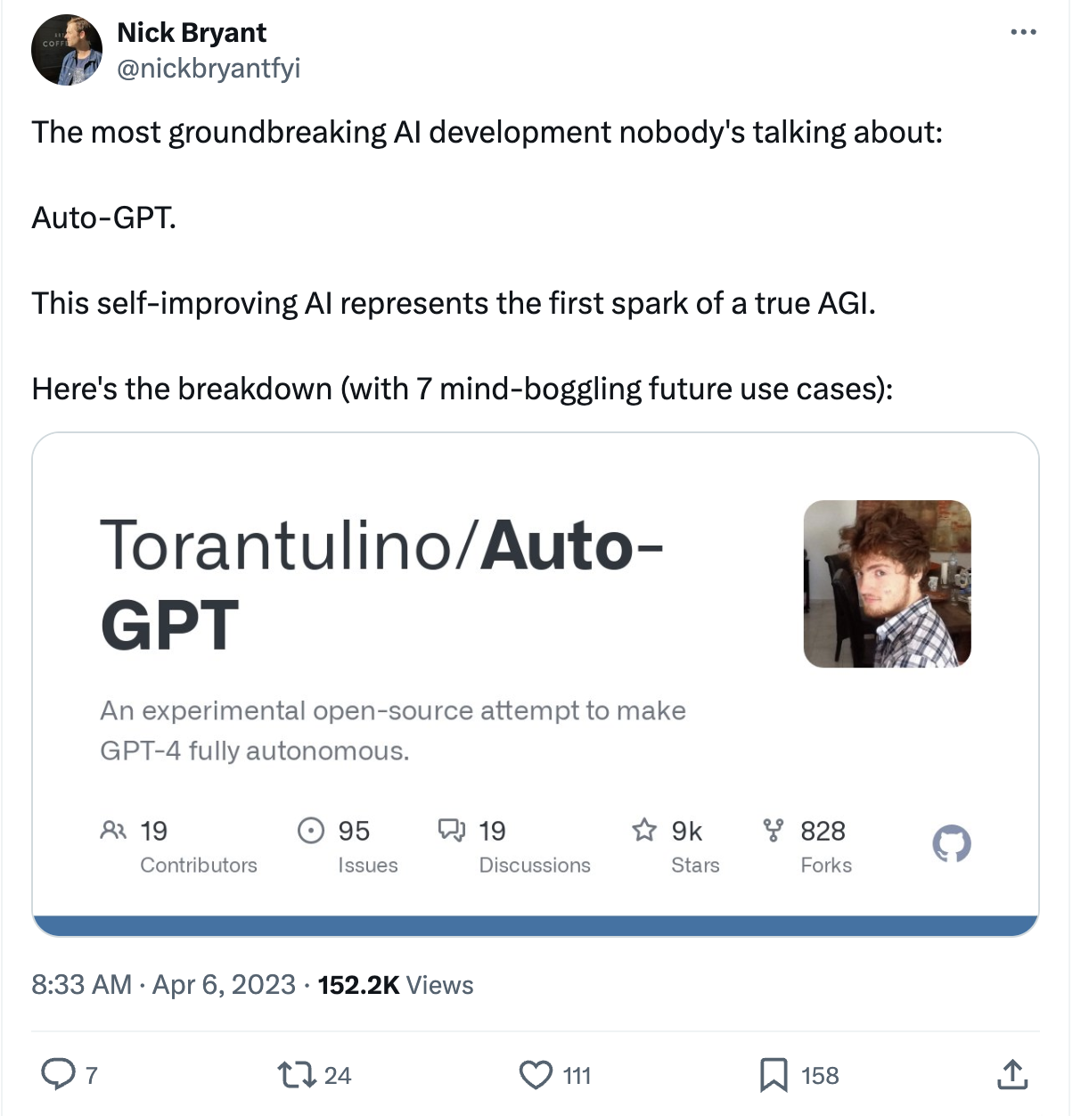
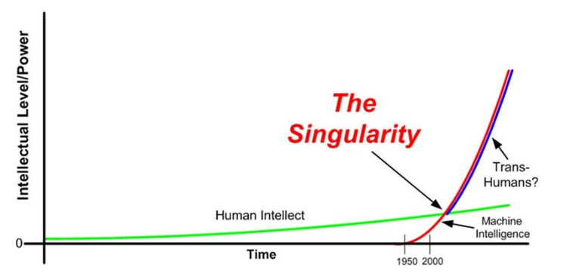
Eutopia/Dystopia where LLMs Self-Improve.
What if LLMs can improve themselves?
Notes:
These successes have prompted the field to raise an interesting question: whether LLMs can self-improve.
Some early results from last year suggested that this might be possible.
In parallel, open-source libraries such as Auto-GPT garnered massive attention on the promise of building self-improving AI agents.
A utopia for those who aspired to build intelligent systems.
And a dystopia for those worried about the increasingly powerful AI systems, especially if such gains get out of our control.

Slide 6
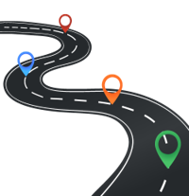
Today
How realistic are these expectations?
Do we see any evidence that AI/LLMs self-grow?
Training-time Self-Feedback
Inference-time Self-Feedback
Notes:
So today, briefly, I would like to revisit the idea of growing language models, with their own feedback.
Specifically, we will look into two settings:
Self-feedback during the training time
Self-feedback during the inference time

Slide 7
Today
How realistic are these expectations?
Do we see any evidence that AI/LLMs self-grow?
Training-time Self-Feedback
Inference-time Self-Feedback

Slide 8
Language Models
Background
Input
text
LM
Output
text
[Bengio et al. ‘04, Peters et al. ‘18, Raffel et al. ‘20, Brown et al. ’20, many others]
Notes:
First, let me start with a little background, to ensure we're all on the same page.
The hero of the day, language models

Slide 9
Language Models
Background
0.2
-0.4
0.1
0.0
-0.5
Input
text
Output
text
[Bengio et al. ‘04, Peters et al. ‘18, Raffel et al. ‘20, Brown et al. ’20, many others]
Notes:
They’re compression engines that are trained to denoise their input.

Slide 10
Language Models
Background
Johns Hopkins University is in _______.
LM
Baltimore
Simple facts
[Bengio et al. ‘04, Peters et al. ‘18, Raffel et al. ‘20, Brown et al. ’20, many others]
Notes:
They already have a lot of knowledge about the world.
For example, Johns Hopkins University is located in ….

Slide 11
Language Modeling ≠ Following User Intents
Background
Explain gravity to a 6-year-old.
Explain black-holes to a 6-year-old.
Explain big bang to a 6-year-old.
….
Explain ”space elevators” to a 6-year-old.
LM
LMs are not “aligned” with user intents [Ouyang et al., 2022].
[Training language models to follow instructions with human feedback, Ouyang et al. 2022]
Notes:
However, that doesn’t mean that off-the-shelf pre-trained models are ready to be used by consumers.
If you ask it to ... they may generate text that, in their lens, is the best continuation to this question.
And that is because there is a disconnect between the pre-training objective and user intents.
In other words, Language models (off-the-shelf, after being pre-trained on unlabeled data) are not yet aligned with user intents.

Slide 12
How do we “align” LMs with our articulated intents?
Background
Notes:
This brings up a question of ...
And there have been a few approaches that I will briefly review.

Slide 13
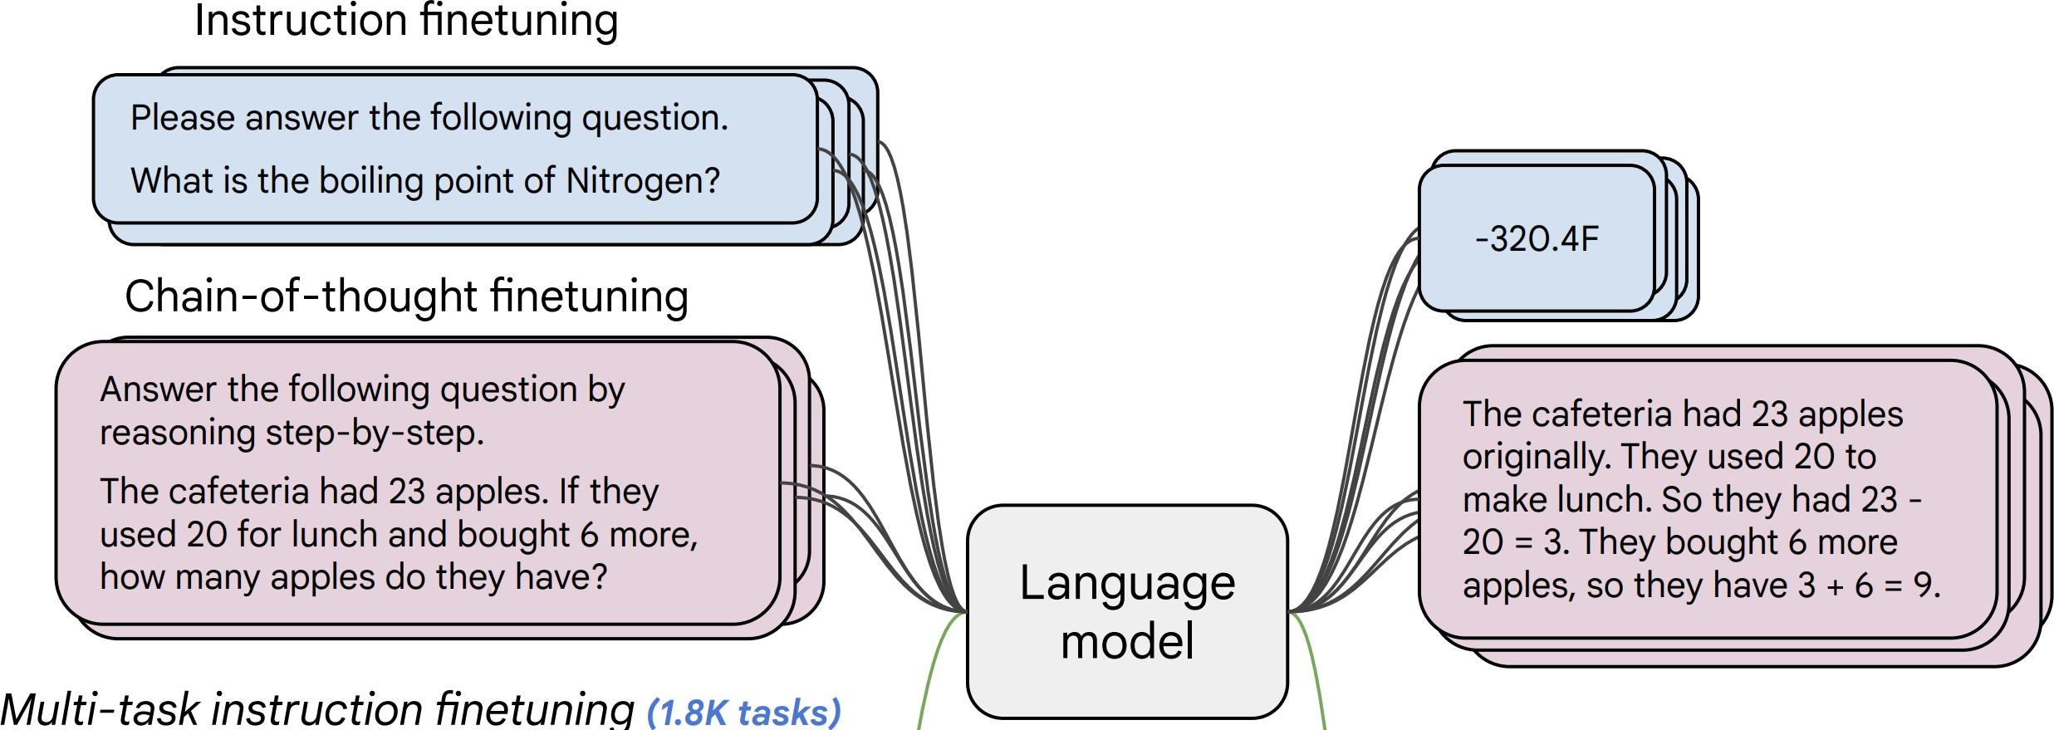
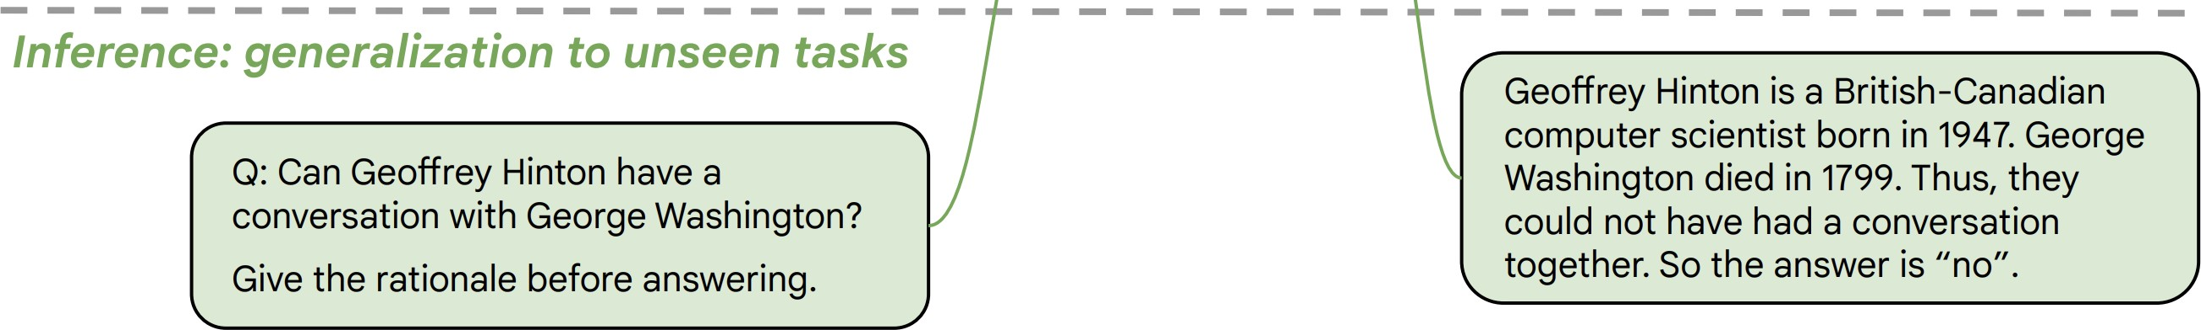
Approach 1: Behavior Cloning (Supervised Learning)
Background
Collect examples of (instruction, output) pairs across many tasks and finetune an LM
2. Evaluate LM on unseen tasks
LM
[McCann et al., 2019, Weller et al. 2020. Mishra et al. 2021; Wang et al. 2022, Sanh et al. 2022; Wei et al., 2022, Chung et al. 2022, many others ]
Notes:
The first approach is behavior cloning or good-old supervised learning on labeled data.
You annotate a collection of input instructions and their desired outputs and train your model on it.
And the hope is that this model would generalize to new, unseen instructions.
This works to some extent. However, it has limitations.

Slide 14
Approach 1: Behavior Cloning (Supervised Learning)
Background
Brittle and sensitive to instruction wordings
Incentivizes word-by-word rote learning => limits creativity
The resulting models’ generality/creativity is bounded by that of their supervision data.
LM
[McCann et al., 2019, Weller et al. 2020. Mishra et al. 2021; Wang et al. 2022, Sanh et al. 2022; Wei et al., 2022, Chung et al. 2022, many others ]
Notes:
While ”behavior cloning” is a great starting point for enabling models to follow human instructions,
The resulting models are often brittle
The outputs are also boring and have limited creativity.
The reason is that these models are trained to mimic human supervision word-by-word. In their training, there is no room for creative generation.
The model that results from behavior cloning is, at most, as good as the training data.

Slide 15
Approach 2: RL w/ Ranking Feedback (RLHF)
Background
1. Reward Learning
2. Policy Gradient
R
It is like any typical elevator, but it goes to space. …
👍
👎
Explain ”space elevators” to a 6-year-old.
LM
👩
Explain gravity to a 6-year-old. …
Explain ”space elevators” to a 6-year-old.
LM
It is basically ….
R
[Christiano et al. 2017; Stiennon et al. 2020; Ouyang et al., 2022]
Notes:
The alternative that the field has pursued is Reinforcement from Human Ranking feedback.
This is done in two stages:
We first train a reward model that can mimic human ratings for various outputs.
And then, given this reward model, we train a language model to generate outputs that maximize the score obtained from the reward model.
- RL is much harder than supervised training for various technical reasons. - But setting those aside, it is a good approach to further improving models that kinda know how how to follow instructions.

Slide 16
The overall recipe 👨‍🍳: Yann’s Three-layered cake
Background
Pre-train
Align (instruct-tune)
Align (RLHF)
Human feedback for aligning LLMs is costly.
Obtaining diverse and quality is quite difficult – not easy to crowdsource.
Notes:
Putting all these together, we get this recipe for building our ChatGPT in our kitchens….
The issue with this pipeline is its latter stages require human annotation.
Human annotations can be difficult and costly to collect.

Slide 17
How far can we reduce the human annotations?
Goal: reduce the role of human annotations.
Pre-train
Align (instruct-tune)
Align (RLHF)
Human feedback for aligning LLMs is costly.
Obtaining diverse and quality is quite difficult – not easy to crowdsource.
Notes:
This motivates us to think about different ways to reduce our reliance on humans and instead use LLMs themselves to align them.

Slide 18





Self-Instruct: Aligning Language Models w/ Self-Generated Instructions
Yizhong Wang, Yeganeh Kordi, Swaroop Mishra, Alisa Liu,
Noah A. Smith, Daniel Khashabi, Hannaneh Hajishirzi
https://arxiv.org/abs/2212.10560

Slide 19
How far can we reduce the human annotations?
Goal: reduce the role of human annotations.
Idea: we can bootstrap “instruction” from off-the-shelf LMs.
LMs have seen humans talk about their needs and goals.
Pretraining
(GPT3*: 499 Billion tokens)
LLMs should know a lot of tasks!
Notes:
Here the goal is to build a good generalist agent, given a vanilla language model.
And the goal is to reduce the reliance on human supervision and rely more on the model’s own feedback.
I would note that here we don't intend to fully replace humans. Obviously, “there's no free lunch” – you need to make assumptions or human feedback to make the problem well-defined. That’s just a necessity.
The intuition is that the pre-trained models are well-read about the world.
•They have seen various articulations of human intentions. If we give them just a few examples, they should be able to extra-populate our intents and answers.

Slide 20
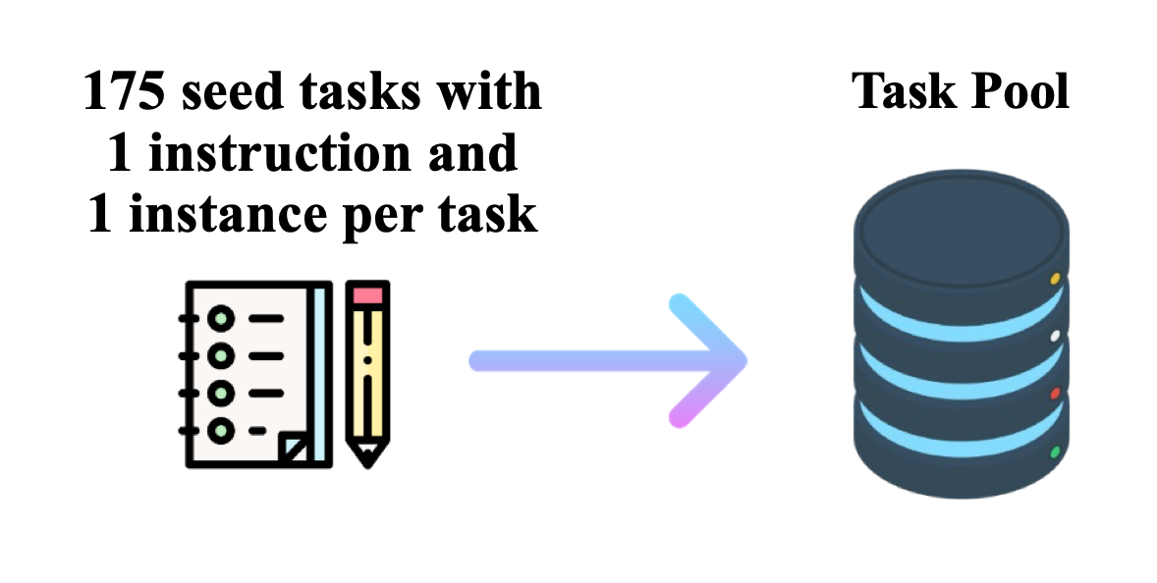
Get humans to write ”seed” tasks ✍️
I am planning a 7-day trip to Seattle. Can you make a detailed plan for me?
Is there anything I can eat for breakfast that doesn’t include eggs, yet includes protein and has roughly 700-100 calories?
Given a set of numbers find all possible subsets that sum to a given number.
Give me a phrase that I can use to express I am very happy.
175 seed tasks

Slide 21
Put them your task bank 📦
I am planning a 7-day trip to Seattle. Can you make a detailed plan for me?
Is there anything I can eat for breakfast that doesn’t include eggs, yet includes protein and has roughly 700-100 calories?
Given a set of numbers find all possible subsets that sum to a given number.
Give me a phrase that I can use to express I am very happy.
175 seed tasks
task pool

Slide 22
Sample and get LLM to expand it
I am planning a 7-day trip to Seattle. Can you make a detailed plan for me?
Is there anything I can eat for breakfast that doesn’t include eggs, yet includes protein and has roughly 700-100 calories?
Given a set of numbers find all possible subsets that sum to a given number.
Give me a phrase that I can use to express I am very happy.
LM
Pre-trained, but not aligned yet
Create a list of 10 African countries and their capital city?
Looking for a job, but it’s difficult for me to find one. Can you help me?
Write a Python program that tells if a given string contains anagrams.
175 seed tasks
task pool
📝
LM suggests new tasks

Slide 23
Get LLM to answers the new tasks
Task: Convert the following temperature from Celsius to Fahrenheit.
Input: 4 °C
Output: 39.2 °F
Task: Write a Python program that tells if a given string contains anagrams.
LM
Pre-trained, but not aligned yet
Input: -
Output: def isAnagram(str1, str2): ...
175 seed tasks
task pool
📝
📝
LM suggests new tasks
LM suggests answers

Slide 24
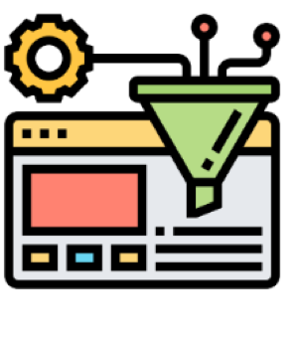
Filter tasks
Drop tasks if LM assigns low probability to them.
Drop tasks if they have a high overlap with one of the existing tasks in the task pool.
Otherwise, common tasks become more common — tyranny of majority.
175 seed tasks
task pool
LM suggests answers
📝
📝
LM suggests new tasks
LM suggests answers
filter out if not novel or confident

Slide 25
Close the loop
Add the filtered tasks to the task pool.
Iterate this process (generate, filter, add) until yield is near zero.
task pool
175 seed tasks
LM suggests answers
📝
📝
LM suggests new tasks
LM suggests answers
filter out if not novel or confident

Slide 26
Self-Instructing GPT3 (base version)
Generate:
GPT3 (“davinci” engine).
We generated 52K instructions and 82K instances.
API cost ~$600
Align:
We finetuned GPT3 with this data via OpenAI API (2 epochs). **
API cost: ~$338 for finetuning
task pool
175 seed tasks
LM suggests answers
📝
📝
LM suggests new tasks
LM suggests answers
filter out if not novel or confident

Slide 27
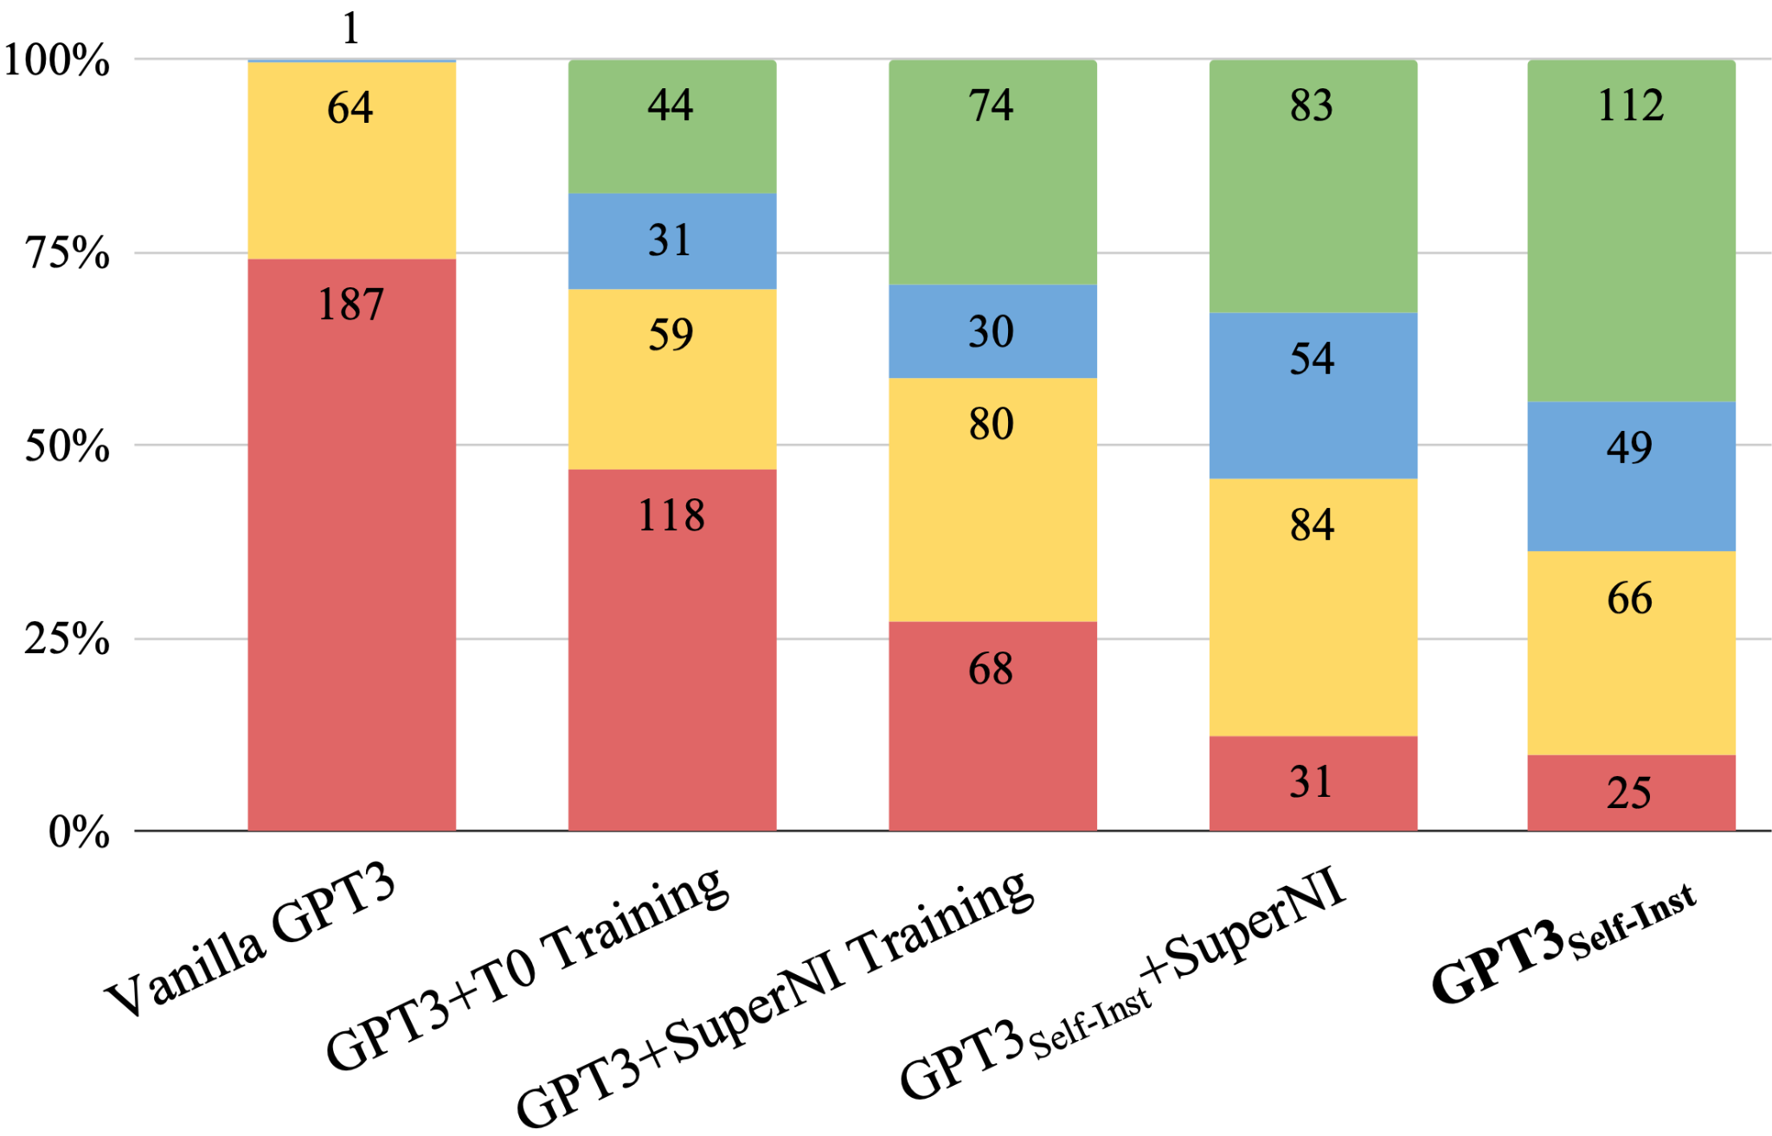
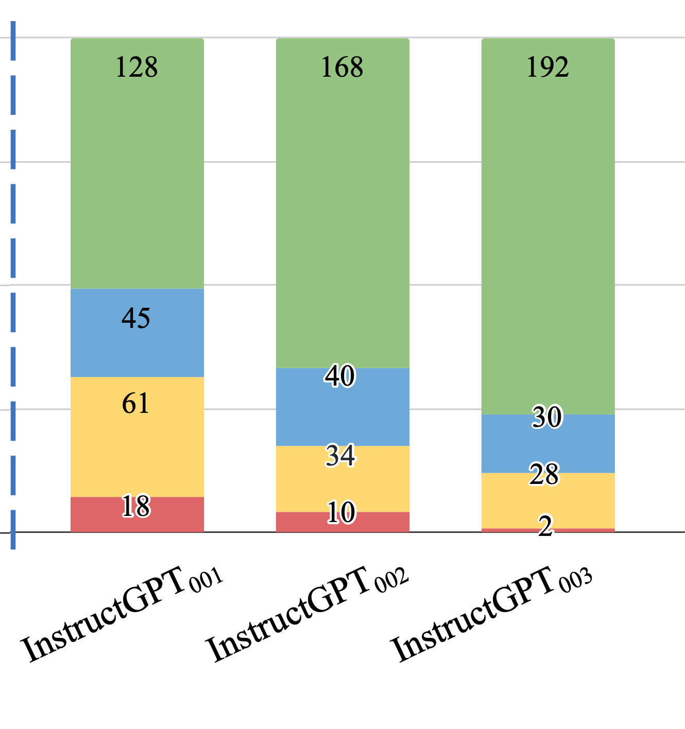
Evaluation on User-Oriented Instructions
Noisy, but diverse “self-instruct” data ~ thousands of clean human-written data
[Self-Instruct: Aligning Language Model with Self-Generated Instructions, Wang et al. 2023]

Slide 28
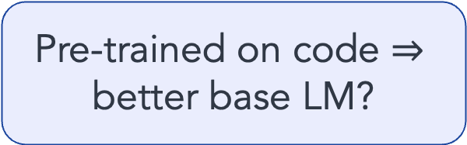
Evaluation on User-Oriented Instructions
LM pretraining
vanilla GPT3 (davinci)
+ instruct-tuning
GPT3-instruct (davinci-001)
+ code pre-training + instruct-tuning
GPT3-instruct (davinci-002)
Pre-trained on code $⇒$ better base LM?
[Self-Instruct: Aligning Language Model with Self-Generated Instructions, Wang et al. 2023]

Slide 29
Evaluation on User-Oriented Instructions
LM pretraining
vanilla GPT3 (davinci)
+ instruct-tuning
GPT3-instruct (davinci-001)
+ code pre-training + instruct-tuning
GPT3-instruct (davinci-002)
+ RLHF
ChatGPT
GPT3-instruct (davinci-003)
[Self-Instruct: Aligning Language Model with Self-Generated Instructions, Wang et al. 2023]

Slide 30
Summary Thus Far
Self-Instruct: Using LLM itself bootstrap alignment data
We can reduce the reliance on human annotations in “alignment”.
LLMs can expand upon examples and diversify the labelled data.
(* See also concurrent work: Unnatural-Instructions [Honovich et al. 2022] and Self-Chat [Xu et al. 2023] )
Notes:
Let me recap what we discussed:
- Self-Instruct: A framework for using LLM itself bootstrap alignment data
- By running this framework, we can reduce the reliance on human annotations in “alignment”.
- This works because LLMs can expand upon examples and diversify the labeled data.

Slide 31
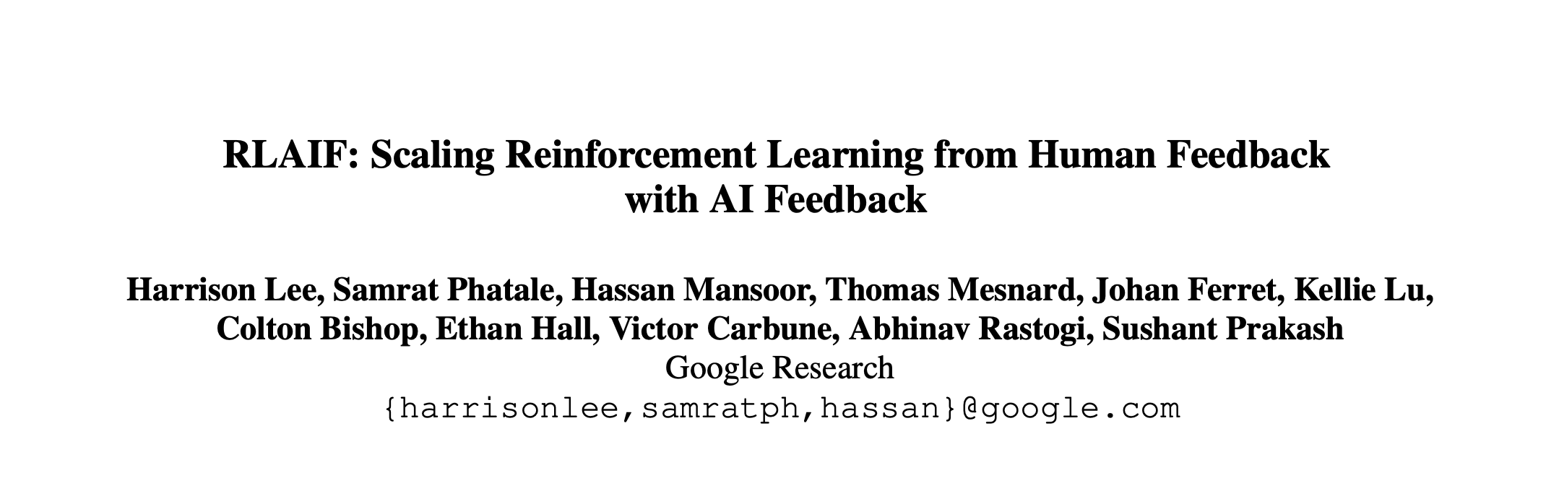
Impact: Learning from AI Feedback
Open-source models adopted Self-Instruct data generation.
Alphaca, Zephyr, etc.
LLMs used directly as a reward during alignment, skipping the data generation.
[Taori et al. 2023; Tunstall et al. 2023]
[Lee et al. 2023; many others]
LM
Model output
Notes:
Since the release of this work, there has been a major adoption:
- There have been multiple open-source models that have adopted “Self-Instruct”-like data generation process.
- Furthermore, follow-up extensions skip the data generation step and directly use the LLM as a reward model for alignment.

Slide 32
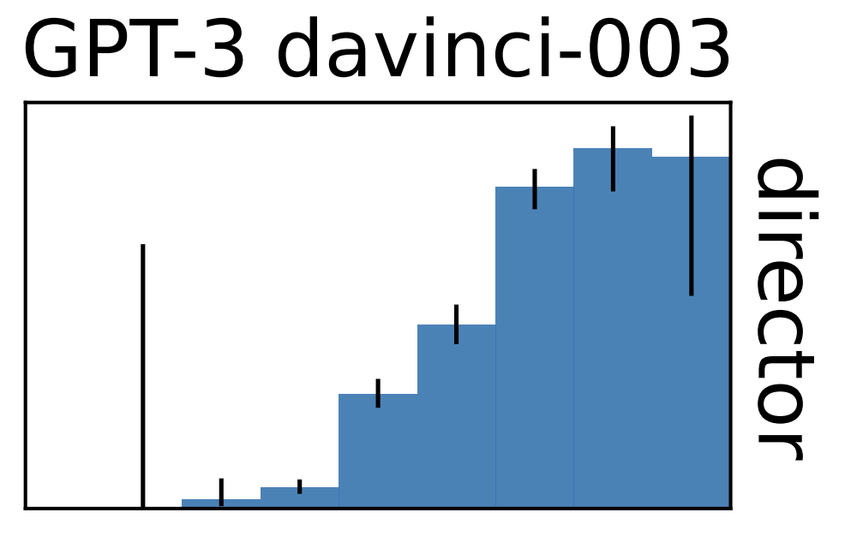
Training LLMs with LLM Feedback: The Bottleneck
Model feedback is a powerful idea, but …
It has many limitations …
It amplifies existing biases.
It is still confined to the [implicit] boundaries defined by the its prompts.
LLMs work best in high-data regime. They fail when data is thin.
Training with self-feedback is not the way to the moon!
LM
Model output
[Mallen et al. 2022; Razeghi et al. 2022; many others]
accuracy
log-popularity
Notes:
But the bad news is that, despite all these are great advances, there are fundamental bottlenecks in all these.
Here are several ones that I would like to point out quickly:
- Using model feedback amplifies existing biases in the model, which is a concern for their safety.
- But more concerning is that, the model’s ability to diversify human annotations is limited. Why? - Model generations are limited to the implicit boundaries defined by the “seed” human annotations
- Because LLMs work best in high-data regimes. Various studies, including ours, have shown a direct relationship between model accuracy and the popularity/frequency of the inputs in pre-training. Their quality will be low when the input instructions are observed less in their pre-training.
This is all to say that, training with self-feedback (despite its potentials) is unlikely to be the path to the moon.

Slide 33
Today
Do we see any evidence that AI/LLMs self-grow?
Training-time Self-Feedback
Inference-time Self-Feedback

Slide 34
Today
Do we see any evidence that AI/LLMs self-grow?
Training-time Self-Feedback
Inference-time Self-Feedback

Slide 35
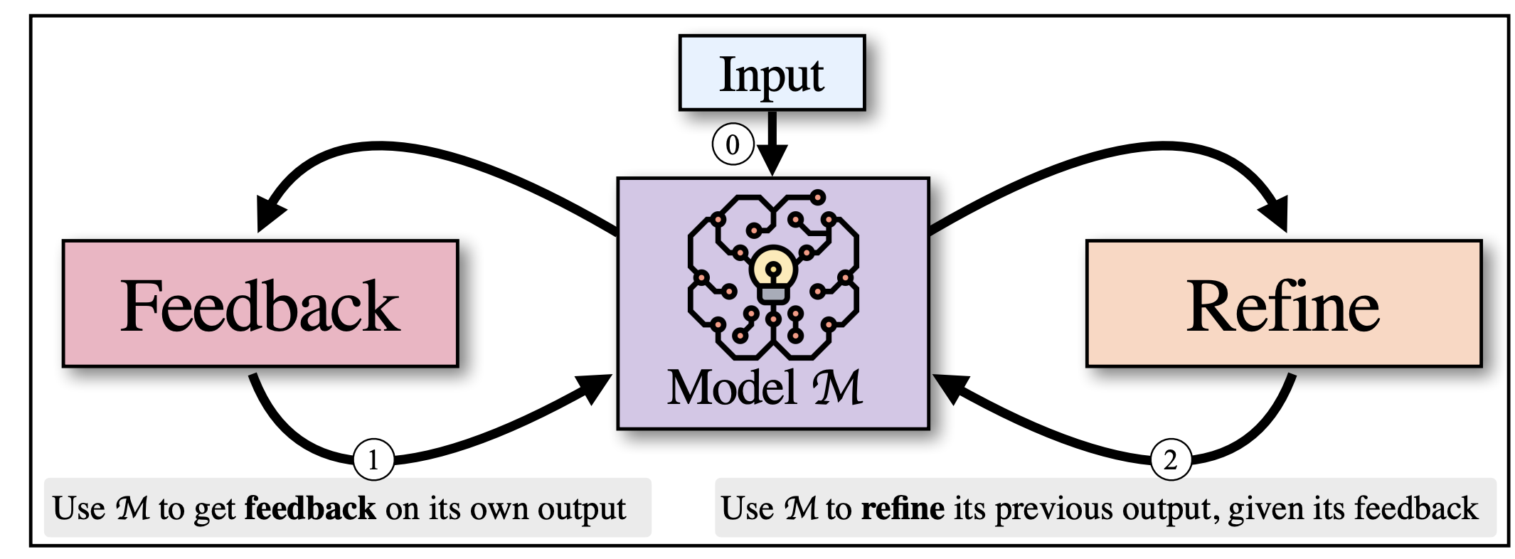
Inference-Time Self-Refinement
If LLMs prompted appropriated, can they improve their previous generations?
[SELF-REFINE: Iterative Refinement with Self-Feedback, Madaan et al., 2023]
[Reflexion: Language Agents with Verbal Reinforcement Learning, Shinn et al., 2023]
Notes:
So the setup is simple:
-Imagine we have a aligned language model such as GPT4.
-Can this model use its own inference time feedback to revise its prior generations?
-
-There have been papers with this motivation in the past few months.
-These papers show that the models can self-improve with their feedback.
-However, these works use various simplifying assumptions. For example, engineering their prompts for specific tasks or using an oracle that can tell the model whether the given answer is correct.
-
-For these reasons, we are suspicious of these claims.
-And hence,

Slide 36
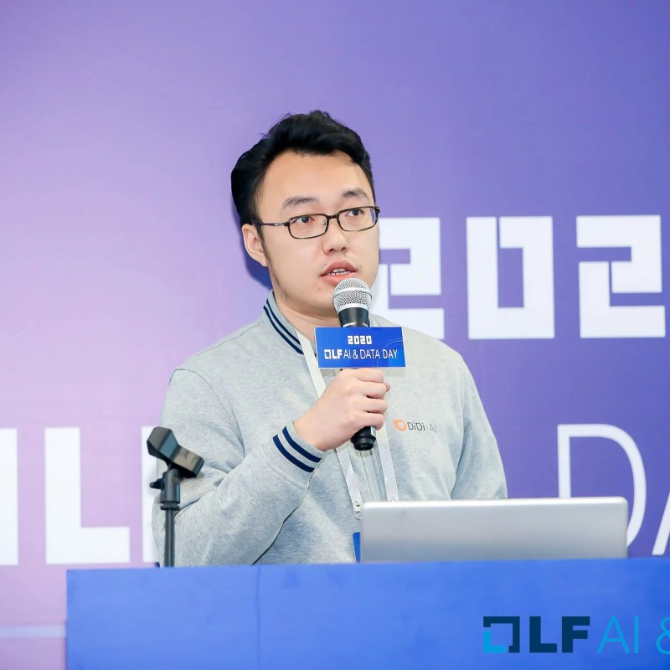




Tangled in Own Thoughts: LLMs Struggle with Refining Self-Generated Responses
Dongwei Jiang, Jingyu Zhang, Orion Weller, Nathaniel Weir
Benjamin Van Durme, Daniel Khashabi
Draft to on arXiv next week!!
Notes:
Hence, we formulated a study to measure LLM’s ability to self-refine.
This paper should be on arxiv next week.

Slide 37
Setup and Hypothesis
Generation
Discrimination
Answer 1
Input
LM
LM
Revised Answer
Answer 2
For inference-time refinement, LLMs should be better at discriminating among previously-generated alternatives than generating initial responses.
Notes:
Let me make the evaluation setup concrete.
- We are given a question
- Given this question, LM generates two or more answers. (let's call this "generation")
- Subsequently, among these previously generated answers, LM selects the best one (let's call this "discrimination").
Intuitively, for LMs to Self-Refine their generation, their ability to discriminate should be better than their ability to generate the initial responses.

Slide 38

Evaluation Setup
Generation prompt
Utah
Question: What was the last US state to reintroduce alcohol after prohibition?
LM
Orlando
sample
Miami
State of Utah
Utah (State)
…
Notes:
Let me just make the evaluation setup more concrete with an example.
Given a question, we sample multiple outputs.

Slide 39
Evaluation Setup
Generation prompt
Utah
Question: What was the last US state to reintroduce alcohol after prohibition?
LM
Orlando
Generation accuracy
sample
Miami
State of Utah
Utah (State)
3/5=60%
…
4
Question: What was the last US state to reintroduce alcohol after prohibition? Here are four choices: (1) {A1}, (2) {A2}, (3) {A3}, (4) {A4} to choose from, please give an answer in 1, 2, 3 and 4 that you think best answers the question.
1
sample
LM
2
1
…
Discrimination prompt
Notes:
-We then figure out which of the answers are correct or not. Here, they're shown based on color-coding. And measure generation accuracy based on that.
- Then, given a list of candidate answers, we create a discrimination prompt for choosing the best candidate, feed it to LM, sample responses, and …

Slide 40
Evaluation Setup
Generation prompt
Utah
Question: What was the last US state to reintroduce alcohol after prohibition?
LM
Orlando
Generation accuracy
sample
Miami
State of Utah
Utah (State)
3/5=60%
…
2/4=50%
4
Question: What was the last US state to reintroduce alcohol after prohibition? Here are four choices: (1) {A1}, (2) {A2}, (3) {A3}, (4) {A4} to choose from, please give an answer in 1, 2, 3 and 4 that you think best answers the question.
1
sample
LM
2
Discrimination accuracy
1
…
Discrimination prompt
Notes:
and measure the accuracy of the selected responses. Which gives us the discrimination accuracy.
That’s the overall discrimination accuracy.

Slide 41
Hypothesis
LLMs are not better discriminating among previously-generated alternatives than generating initial responses.
Discrimination accuracy
Generation accuracy

Slide 42
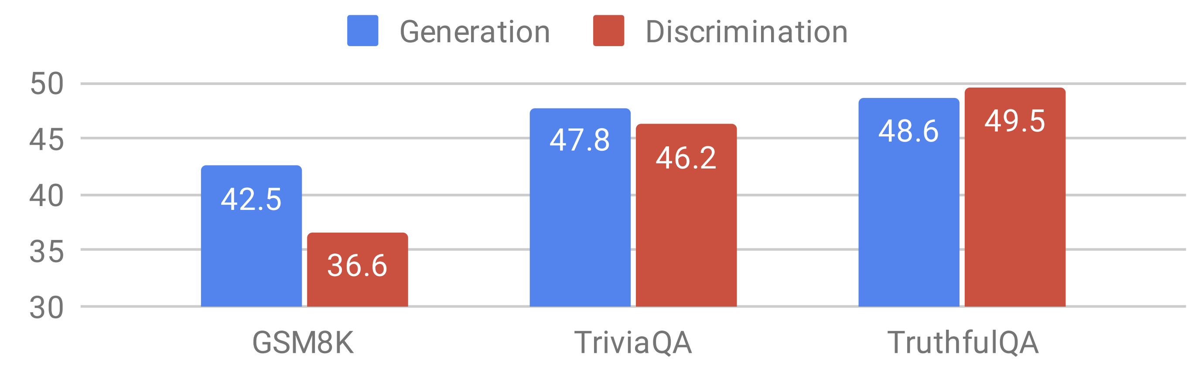
Evaluation Results
LLaMA-2 70B Chat
There is no evidence that discriminating among candidates is necessarily an easier task than generating answers.
Notes:
Here is one such evaluation on three different datasets via LLAMA-2 70B parameters.
As you can see, there is no evidence that discriminating among candidates is necessarily easier than generating answers.
In fact, in some cases, the generation accuracy is even higher!
What if this is a fluke specific to LLAMA-2?

Slide 43
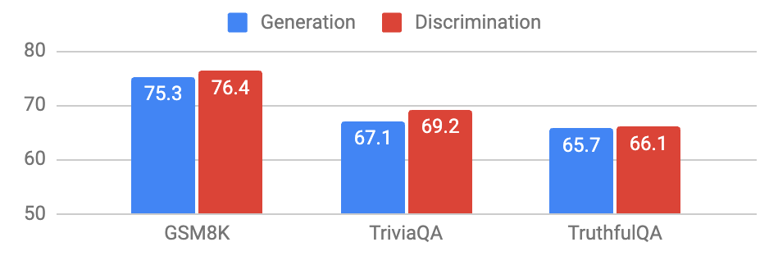
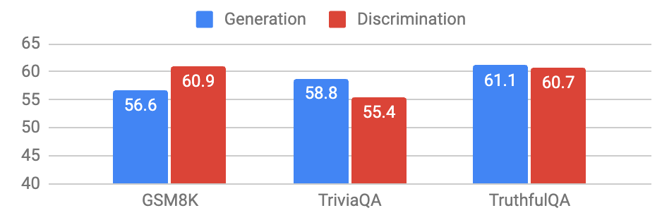
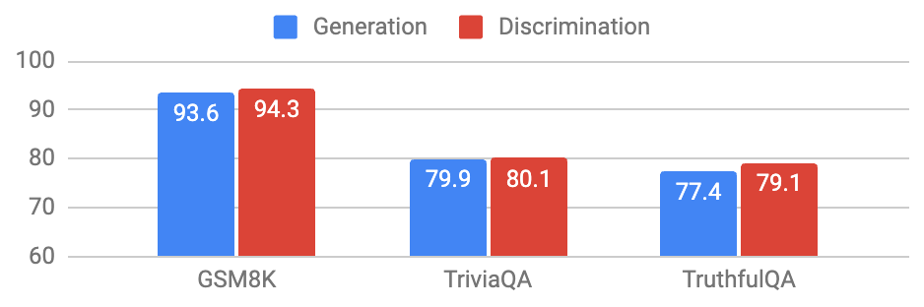
There is no evidence that discriminating among candidates is necessarily an easier task than generating answers.
LLaMA-2 70B Chat
GPT-3.5-turbo
Mixtral-8x7B-Instruct
GPT-4
Notes:
We also evaluated it on 4 different models.
And the result is again the same: There is no evidence that …

Slide 44
Does Hand-holding ”Discrimination” Help?
One can do

Slide 45
Why is ”Discrimination” not Easier than “Generation”?
Sub-hypothesis: Pre-training objective (next-token prediction) benefits generation more.
Sub-hypothesis: Alignment datasets are skewed toward generative tasks.
Sub-hypothesis: Length generalization benefits generation more.
We have partial evidence for all these.
Notes:
Why Is this case? Why is ”Discrimination” not Easier than “Generation”?
We have a bunch of sub-hypothesis:
- One hypothesis is that the Pre-training objective (next-token prediction) benefits generation more.
- Another hypothesis is that the alignment datasets (many of which are not public) are skewed toward generative tasks. That’s just the data bias.
- Finally, this can be an artifact of LLMs' length generalization bias. Shorter prompts tend to be preferred over longer ones.
In our paper, we discuss these more extensively and do some analysis. But ultimately, we can’t pinpoint exactly any of them as the key underlying reason.

Slide 46
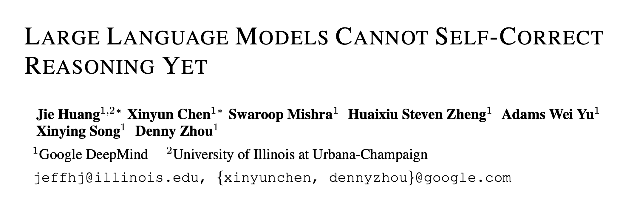
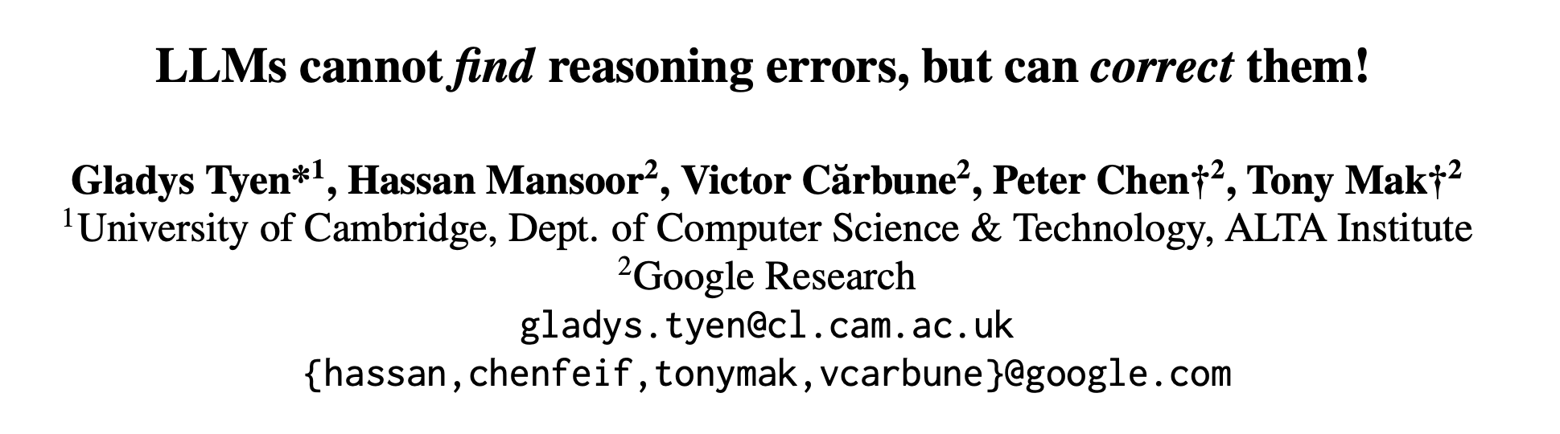
Summary of this work
We do not see any evidence that inference-time refinement of answers leads to consistent gains.
Parallel works
ICLR 2024
arXiv 2023
Notes:
To summarize,
The motivation for this study was, whether LLMs can enjoy inference-time self-improvements.
we do not see any evidence that inference-time refinement of answers leads to consistent gains.
I would also highlight two parallel works that came out in the past few months with a similar finding but a different experimental setting.

Slide 47

Growing Chatbots Out of Thin-Air
Training-time Self-Feedback
Inference-time Self-Feedback
Notes:
To tie things together, let me return to this slide I started with.
We explored using self-feedback for two stages,
- At training models, some success here, but as I mentioned, there are fundamental bottlenecks.
-We also talked about inference-time self-feedback. And as we just discussed, there is no evidence of significant improvements during the inference time.
-So, in summary, ladies and gentlemen, based on our current technology there is no evidence that we can grow chatbots out of thin air indefinitely.
-Can this change in the future? Of course. For that to happen, we need a fundamental paradigm shift in our model design.

Slide 48
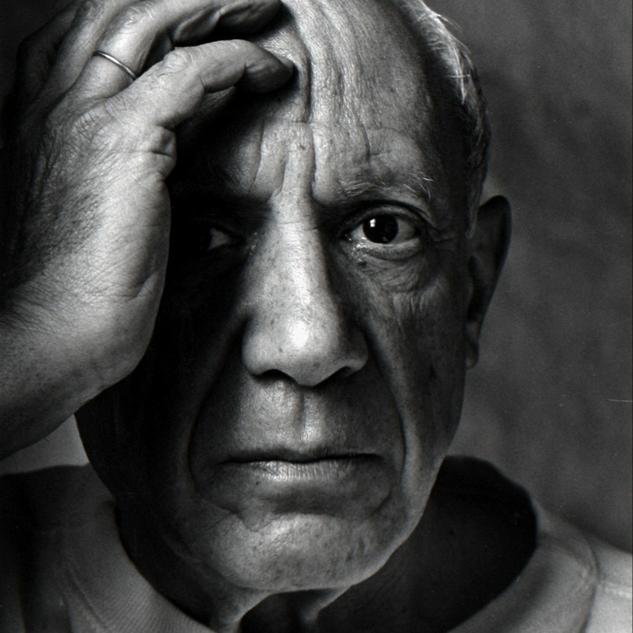
Success of AI Depends on “Assumptions”
It is true that “self-supervised learning” has been an effective force for growing models via unlabeled data.
Yet, your model will work if it has seen similar-ish problems.
We always need to make assumptions about tasks, domain, and data (e.g., “prompt-engineering”).
“Computers are useless. They can only give you answers”
-- Pablo Picasso, 1968
Notes:
If you take a step back and look at the recent successes of AI, beyond just pre-training, the rest always relies on “assumptions.”
For example,
- the assumption that the task you’re about to solve has been observed somewhere in the pre-training data.
- Or assumptions about how detailed a response you need.
- Every time you do prompt engineering, you’re encoding more and more of your assumptions into the model.
- And assumptions are good for making things work.
- However, assumptions also create boundaries for what you can expect from your model.
- Relatedly, half a century ago, Pablo Picasso once said:
…..
- Meaning that computers (then and now) can solve a problem if you define it for them via assumptions.
- But maybe the difficult part is defining the question. It takes genius and creativity to define good questions.

Slide 49

Intelligence Continues to be a Moving Target
Every step forward, we realize there are new challenges ahead.
Notes:
I’ll leave you with one message: intelligence remains a moving target.
Every step forward, we realize that new challenges were not obvious before.
And means that academic environments like Hopkins will need to play a big role in leading the way forward.
I’ll stop here.

Slide 50
Thanks!

